Slide 1

CSE 473
Pattern Recognition

Slide 2
Classifiers, Discriminant Functions and Decision Surfaces

Slide 3
Classifiers, Discriminant Functions and Decision Surfaces
Remember the Bayesian classifier:

Slide 4
Classifiers, Discriminant Functions and Decision Surfaces
Remember the Bayesian classifier:
g_{i}(x) > g_{j}(x)

Slide 5
Classifiers, Discriminant Functions and Decision Surfaces
Remember the Bayesian classifier:
This is equivalent to:
decide x to class ω_{i}
if g_{i}(x) > g_{j}(x) ∀j ≠ i
where, g_{i}(x) =P(ω_{i}|x), i = 1,…, c

Slide 6
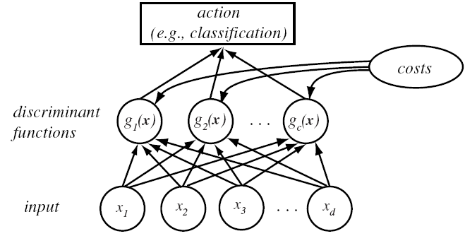
Classifiers, Discriminant Functions
and Decision Surfaces
Discriminant Functions
d- dimensional Feature vector

Slide 7
Classifiers, Discriminant Functions
and Decision Surfaces
Based on minimum risk classification
  Let g_{i}(x) = - R(α_{i} | x)
(max. discriminant corresponds to min. risk!)

Slide 8
Classifiers, Discriminant Functions
and Decision Surfaces
For the minimum error rate, we take
  g_{i}(x) = P(ω_{i} | x)
(max. discrimination corresponds to max. posterior!)

Slide 9
Classifiers, Discriminant Functions
and Decision Surfaces
For the minimum error rate, we take
  g_{i}(x) = P(ω_{i} | x)
some alternate representations but giving similar results
g_{i}(x) ≡ P(x | ω_{i}) P(ω_{i})
g_{i}(x) ≡ ln P(x | ω_{i}) + ln P(ω_{i})
(ln: natural logarithm!)

Slide 10
Decision Surface
Let, R_{i} and R_{j} : two regions identifying classes ω_{i} and ω_{j}
R_{i}
R_{j}

Slide 11
Decision Surface
Let, R_{i} and R_{j} : two regions identifying classes ω_{i} and ω_{j}
Decision Rule
Decide ω_{i} if P(ω_{i} |x) > P(ω_{j} |x)
R_{i}
R_{j}

Slide 12
Decision Surface
Let, R_{i} and R_{j} : two regions identifying classes ω_{i} and ω_{j}
Decision Rule
Decide ω_{i} if P(ω_{i} |x) - P(ω_{j} |x) > 0
R_{i}
R_{j}

Slide 13
Decision Surface
Let, R_{i} and R_{j} : two regions identifying classes ω_{i} and ω_{j}
Decision Rule
Decide ω_{i} if g(x) ≡ P(ω_{i} |x) - P(ω_{j} |x) > 0
R_{i}
R_{j}

Slide 14
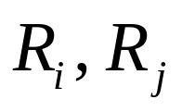
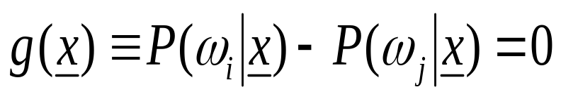
Decision Surface
Let, : two regions identifying classes ω_{i} and ω_{j}

Slide 15

Decision Surface
If : two regions identifying classes ω_{i} and ω_{j}
decision surface

Slide 16
Decision Surface
If : two regions identifying classes ω_{i} and ω_{j}
+
-
decision surface

Slide 17
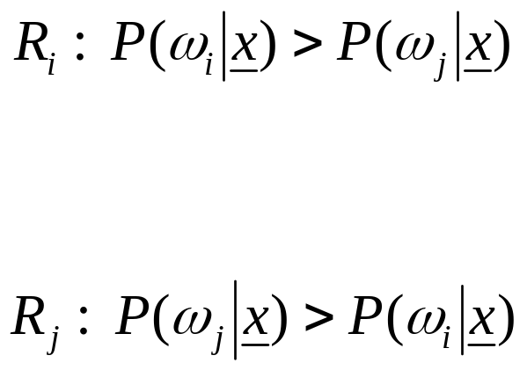
Decision Surface
If : two regions identifying classes ω_{i} and ω_{j}
+
-
decision surface

Slide 18
Decision Surface in Multi-categories
Feature space is divided into c decision regions
if g_{i}(x) > g_{j}(x) ∀j ≠ i then x is in R_{i}
(R_{i} means: assign x to ω_{i})

Slide 19
Decision Surface in Two-categories
The two-category case
  A classifier is a “dichotomizer” that has two discriminant functions g₁ and g₂
  Let g(x) ≡ g₁(x) – g₂(x)
  Decide ω₁ if g(x) > 0 ; Otherwise decide ω₂

Slide 20
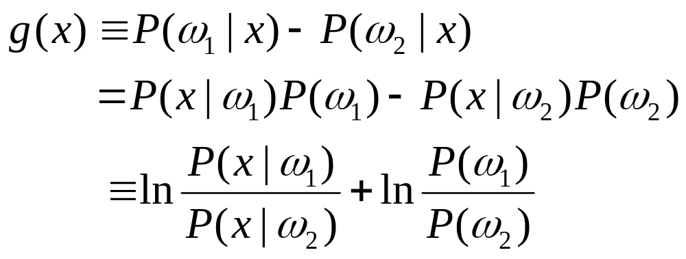
  The computation of g(x)

Slide 21
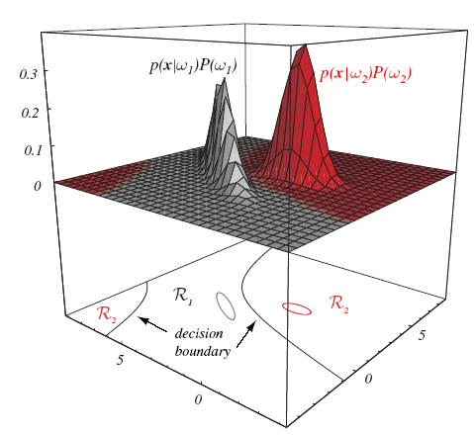

Slide 22
The Normal Density
Density which is analytically tractable
Continuous density
A lot of processes are asymptotically Gaussian
  Handwritten characters, speech sounds, and many more
  Any prototype corrupted by random process

Slide 23
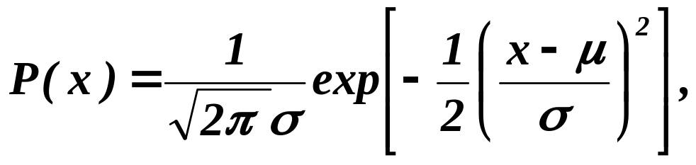
The Normal Density
Univariate density
Where:
μ = mean (or expected value) of x
σ² = expected squared deviation or variance

Slide 24
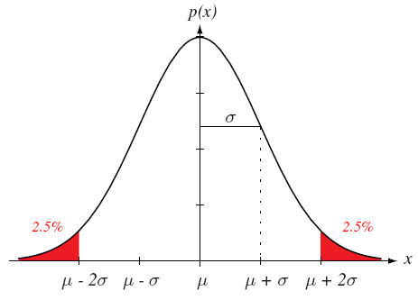

Slide 25
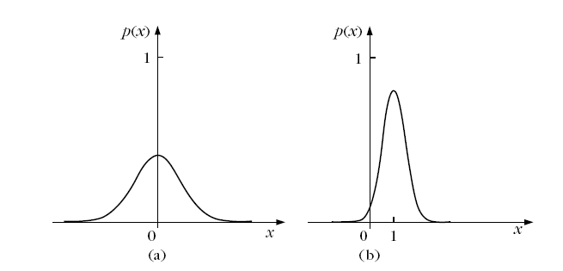

Slide 26
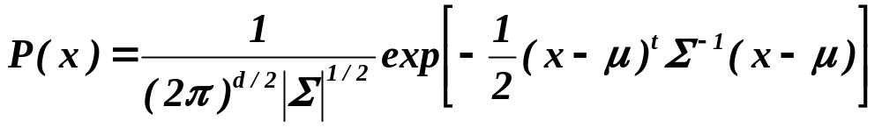
Multivariate density
  Multivariate normal density in d dimensions is:
where:
x = (x₁, x₂, …, x_{d})^{t} (t stands for the transpose vector form)
μ = (μ₁, μ₂, …, μ_{d})^{t} mean vector
Σ = d*d covariance matrix
|Σ| and Σ⁻¹ are determinant and inverse respectively

Slide 27

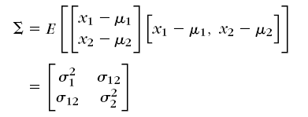
Multivariate density
  Multivariate normal density in d dimensions is:
where:

Slide 28


Slide 29

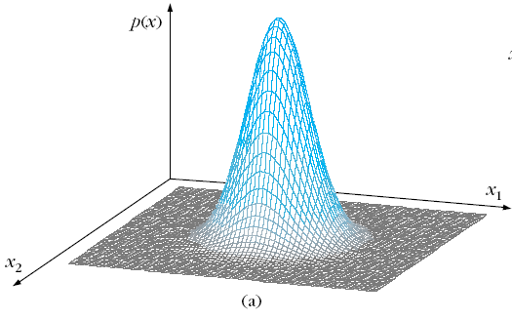
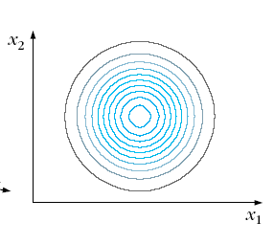
2D Gaussian Example - 1

Slide 30
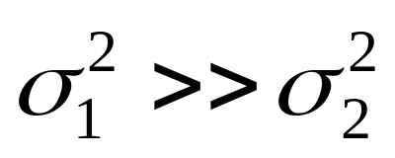
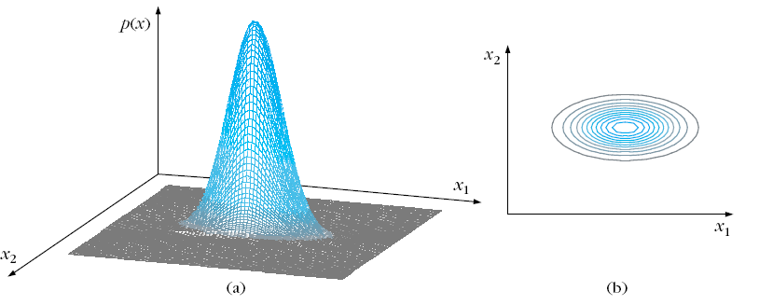
2D Gaussian Example - 2

Slide 31
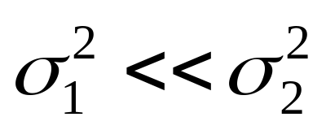
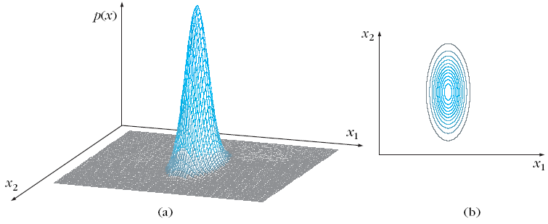
2D Gaussian Example - 3

Slide 32
Computer Exercise
Use matlab to generate Gaussian plots
Try with different Σ and б

Slide 33
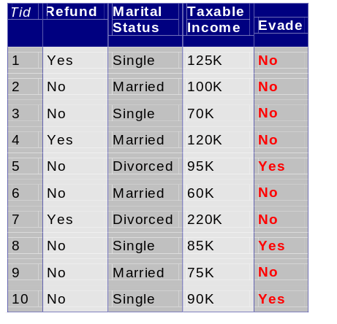
Classification Example 2
A married person with income 120K did not refund the loan previously
Can we trust him?

Slide 34
Bayesian Classifiers
We have multiple attributes (A₁, A₂,…,A_{n})
  Goal is to predict class C
  Specifically, we want to find the value of C that maximizes P(C| A₁, A₂,…,A_{n} )
Can we estimate P(C| A₁, A₂,…,A_{n} ) directly from data?

Slide 35
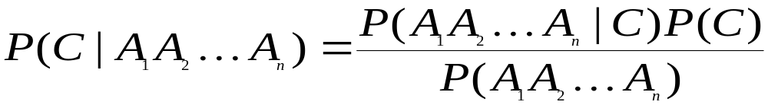
Bayesian Classifiers
Approach:
  compute the posterior probability P(C | A₁, A₂, …, A_{n}) for all values of C using the Bayes theorem
  Choose value of C that maximizes
  P(C | A₁, A₂, …, A_{n})
  Equivalent to choosing value of C that maximizes
  P(A₁, A₂, …, A_{n}|C) P(C)
How to estimate P(A₁, A₂, …, A_{n} | C )?

Slide 36
Naïve Bayes Classifier
Assume independence among attributes A_{i} when class is given:
  P(A₁, A₂, …, A_{n} |C_{j}) = P(A₁| C_{j}) P(A₂| C_{j})… P(A_{n}| C_{j})
  Can estimate P(A_{i}| C_{j}) for all A_{i} and C_{j}
  the new pattern is classified to C_{j} if P(C_{j}) Π P(A_{i}| C_{j}) is maximum

Slide 37
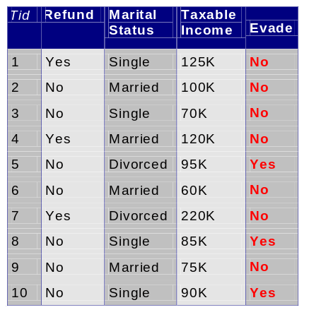
How to Estimate Probabilities from Data?
Class: P(C) = N_{c}/N
  e.g., P(No) = 7/10,
  P(Yes) = 3/10
For discrete attributes:
P(A_{i} | C_{k}) = |A_{ik}|/ N_{c}
  where |A_{ik}| is number of instances having attribute A_{i} and belongs to class C_{k}
  Examples:
  P(Status=Married|No) = 4/7
  P(Refund=Yes|Yes)=0

Slide 38
How to Estimate Probabilities from Data?
For continuous attributes:
  Discretize the range into bins
    one ordinal attribute per bin
  Two-way split: (A < v) or (A > v)
    choose only one of the two splits as new attribute
  Probability density estimation:
    Assume attribute follows a normal distribution
    Use data to estimate parameters of distribution
    (e.g., mean and standard deviation)
    Once probability distribution is known, can use it to estimate the conditional probability P(A_{i}|c)

Slide 39
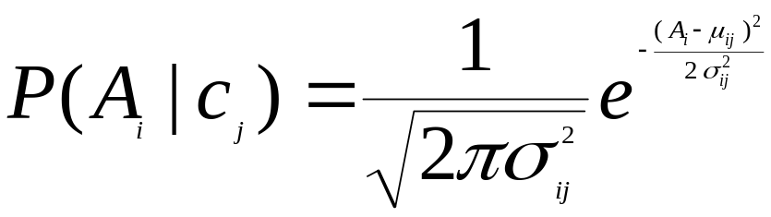
How to Estimate Probabilities from Data?
Normal distribution:
  One for each (A_{i},c_{j}) pair
For (Income, Class=No):
  If Class=No
    sample mean = 110K
    sample variance = 2975

Slide 40
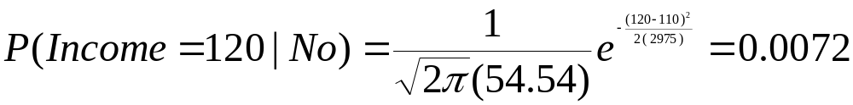
How to Estimate Probabilities from Data?
Normal distribution:
  One for each (A_{i},c_{j}) pair
For (Income, Class=No):
  If Class=No
    sample mean = 110K
    sample variance = 2975

Slide 41
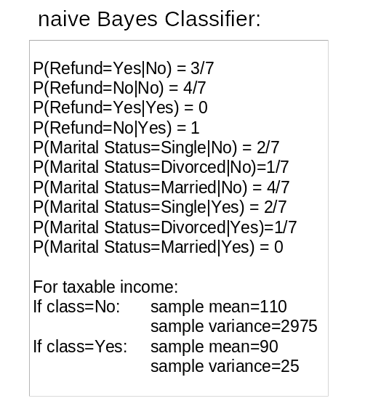
Example of Naïve Bayes Classifier
Given a Test Record:
P(X|Class=No) = P(Refund=No|Class=No)
× P(Married| Class=No)
× P(Income=120K| Class=No)
= 4/7 × 4/7 × 0.0072 = 0.0024
P(X|Class=Yes) = P(Refund=No| Class=Yes)
× P(Married| Class=Yes)
× P(Income=120K| Class=Yes)
= 1 × 0 × 1.2 × 10⁻⁹ = 0
Since P(X|No)P(No) > P(X|Yes)P(Yes)
Therefore P(No|X) > P(Yes|X)
=> Class = No

Slide 42
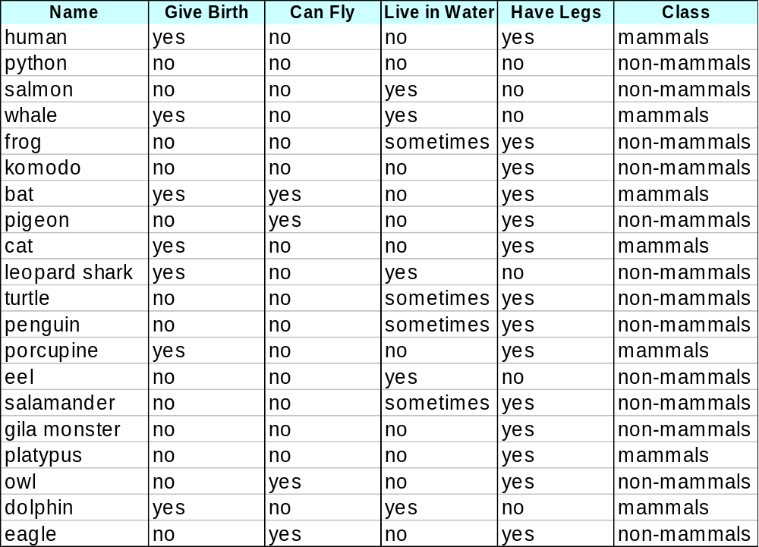
Example-2 of Naïve Bayes Classifier

Slide 43
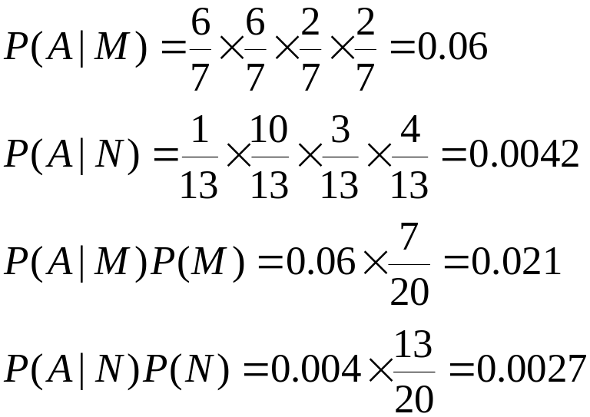
Example-2 of Naïve Bayes Classifier
A: attributes
M: mammals
N: non-mammals
P(A|M)P(M) > P(A|N)P(N)
=> Mammals

Slide 44
Naïve Bayes (Summary)
Robust to isolated noise points
Handle missing values by ignoring the instance during probability estimate calculations
Robust to irrelevant attributes
Independence assumption may not hold for some attributes
  Use other techniques such as Bayesian Belief Networks (BBN)

Slide 45
Naïve Bayes (Issues)
Over simplification
  Use other techniques such as Bayesian Belief Networks (BBN)

Slide 46
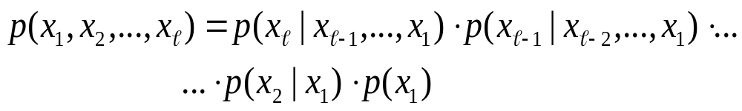
Bayesian Belief Networks
Let we have l random variables
The joint probability is given by,

Slide 47
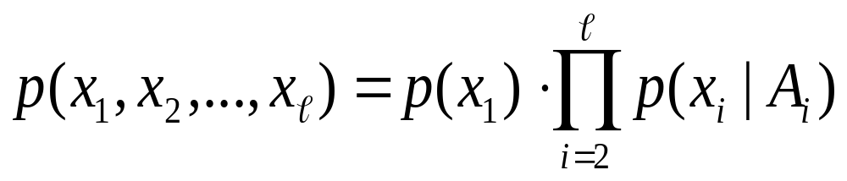
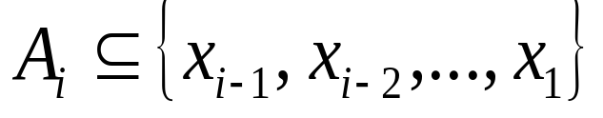
Bayesian Belief Networks
  The formula
  can be written as
  where

Slide 48
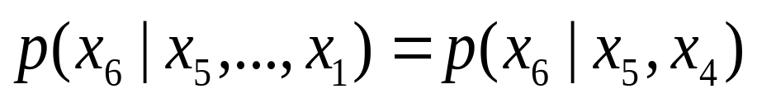
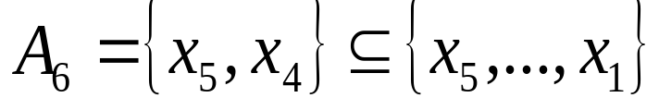
  For example, if ℓ=6, then we could assume:
  Then:

Slide 49
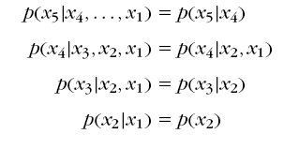

  Simialrly, if we assume
  Then:

Slide 50
  Simialrly, if we assume
  Then:
  The above is a generalization of the Naïve – Bayes. For the Naïve – Bayes the assumption is:
  A_{i} = Ø, for i=1, 2, …, ℓ

Slide 51
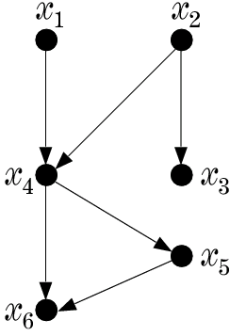
  A graphical way to portray conditional dependencies

Slide 52
  A graphical way to portray conditional dependencies
  According to this figure we have :
    x₆ is conditionally dependent on x₄, x₅.
    x₅ on x₄
    x₄ on x₁, x₂
    x₃ on x₂
    x₁, x₂ are conditionally independent on other variables.

Slide 53
  A graphical way to portray conditional dependencies
  According to this figure we have :
    x₆ is conditionally dependent on x₄, x₅.
    x₅ on x₄
    x₄ on x₁, x₂
    x₃ on x₂
    x₁, x₂ are conditionally independent on other variables.
  For this case:

Slide 54
Bayesian Networks
  a directed acyclic graph (DAG)
  the nodes correspond to random variables
  arc represents parent-child (dependence) relationship

Slide 55
A Bayesian Network is specified by:
  The prior probabilities of its root nodes.
  The conditional probabilities of the non-root nodes, given their parents, for ALL possible combinations.

Slide 56
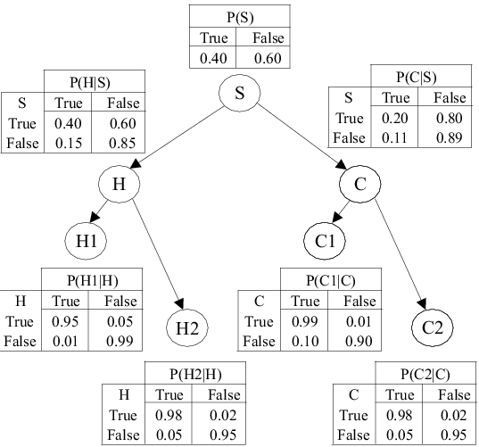
  A Bayesian Network from a medical application
  This BBN models conditional dependencies concerning smokers’ (S), tendencies to develop cancer (C) and heart disease (H), together with variables corresponding to heart (H1, H2) and cancer (C1, C2) medical tests.

Slide 57
  any joint probability can be obtained by multiplying the prior (root nodes) and the conditional (non-root nodes) probabilities.
  Training: given a topology, probabilities are estimated from training data. There are also methods that learn the topology.
  Probability Inference: Given a pattern (evidence), the goal is to compute the conditional probabilities for some of the other variables (class)

Slide 58
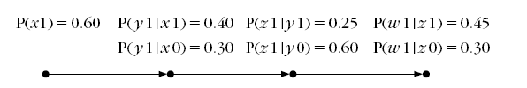
Example: Consider the Bayesian network of the figure:
Random variables: x, y, w, z
x0 means x = 0
x1 means x = 1
x
y
z
w

Slide 59
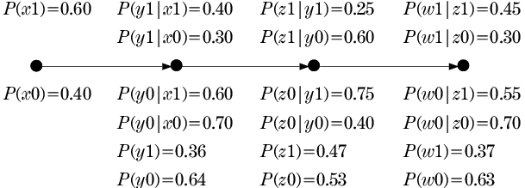
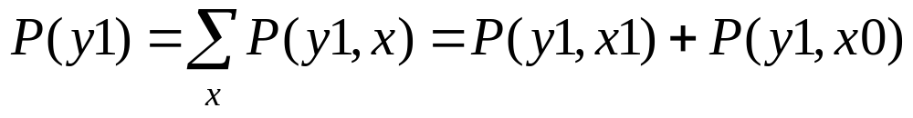
We can calculate the other probabilities
Example: p(y₁):
x
y
z
w

Slide 60
We can calculate the other probabilities
x
y
z
w

Slide 61
Given this info, we can answer any probabilistic query:
a) If x is measured to be x=1 (x1), compute P(z1|x1) and P(w0|x1).
b) If w is measured to be w=1 (w1) compute P(z1|w1)].
x
y
z
w

Slide 62
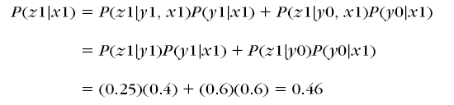
a) If x is measured to be x=1 (x1), compute P(z1|x1) and P(w0|x1).
x
y
z
w

Slide 63
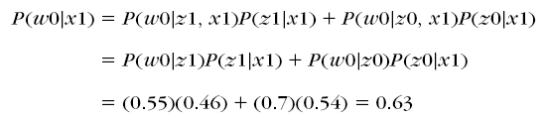
a) If x is measured to be x=1 (x1), compute P(z1|x1) and P(w0|x1).
x
y
z
w

Slide 64

b) If w is measured to be w=1 (w1) compute P(z1|w1|)].
x
y
z
w

Slide 65
c) CAN WE CALCULATE P(x0|w1|)]?
x
y
z
w

Slide 66
What’s about more complex networks?

Slide 67
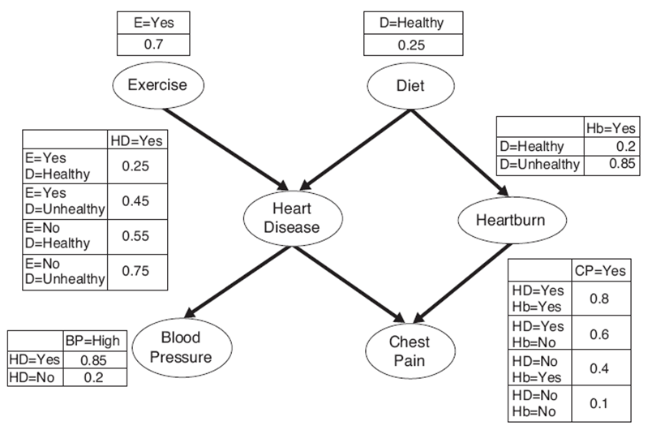
What’s about more complex networks?

Slide 68
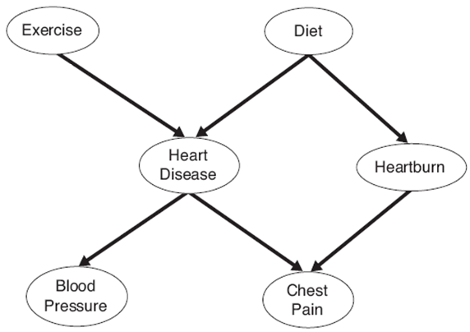
We will study this graph
We can show:
P(D|E)=P(D)
P (Hb|HD, E, D)= P (Hb|D)
P (CP|Hb, HD, E, D)= P (CP|Hb, HD)
P (BP|CP, Hb, HD, E, D)= P (BP|HD)
However, P (HD|E,D) cannot be simplified

Slide 69
Exercise:
P (CP|HD, BP, E, D)= ?

Slide 70
Exercise:
P (CP|HD, BP, E, D)= No simplification

Slide 71
Calculate P(HD=yes) ?

